Slide 1
Tridiagonal Matrices
Amirkabir University of Technology-Birmingham University
Bahram Taheri

Slide 2
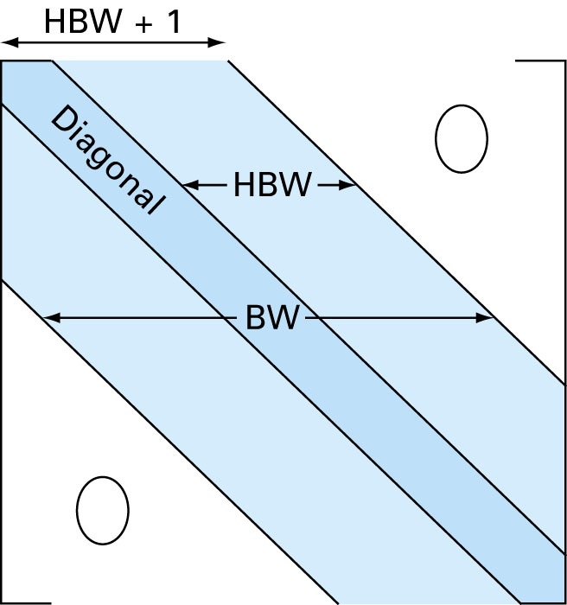
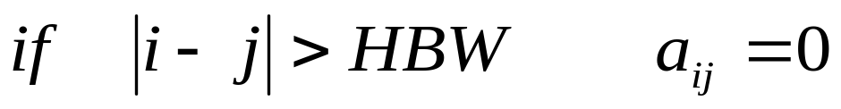
Special Matrices
(Banded Matrix)
BW (Band width):
HBW(Half-band width):
BW = 2HBW + 1

Slide 3
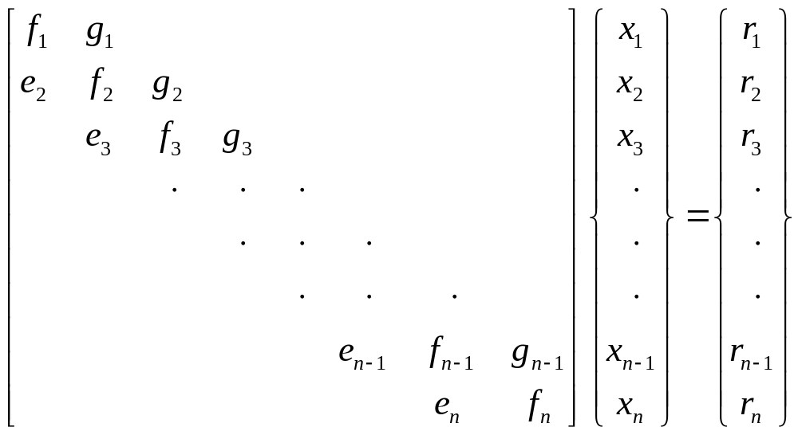
Tridiagonal Matrices
(BW = 3)
We have changed our notation for the coefficients from a’s and b’s to e’s, f’s, and g’s to avoid storing large number of useless zeros

Slide 4
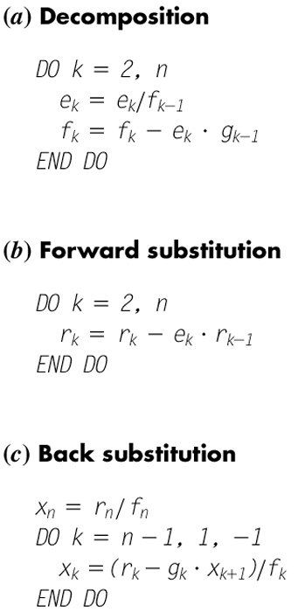
Thomas Algorithm for Solving Tridiagonal Matrices
Decomposition
Forward Substitution
Backward Substitution
Ex. Practice by hand

Slide 5
Thomas Algoritm Pseudo-Code
Sub Thomas(e, f, g, r, n, x)
Call Decomp(e, f, g, n)
Call Substitute(e, f, g, r, n, x)
End Sub
Sub Decomp(e, f, g, n)
Dim k As Integer
For k = 2 To n
e(k) = e(k) / f(k - 1)
f(k) = f(k) - e(k) * g(k - 1)
Next k
End Sub

Slide 6
Thomas Algorithm Pseudo-Code Continued
Sub Substitute(e, f, g, r, n, x)
Dim k As Integer
For k = 2 To n
r(k) = r(k) - e(k) * r(k - 1)
Next k
x(n) = r(n) / f(n)
For k = n - 1 To 1 Step -1
x(k) = (r(k) - g(k) * x(k + 1)) / f(k)
Next k
End Sub

